Slide 1
Differentiating Casual and Member Riders for Designing a Targeted Conversion Strategy
December 2023 Nayan Kadhre

Slide 2
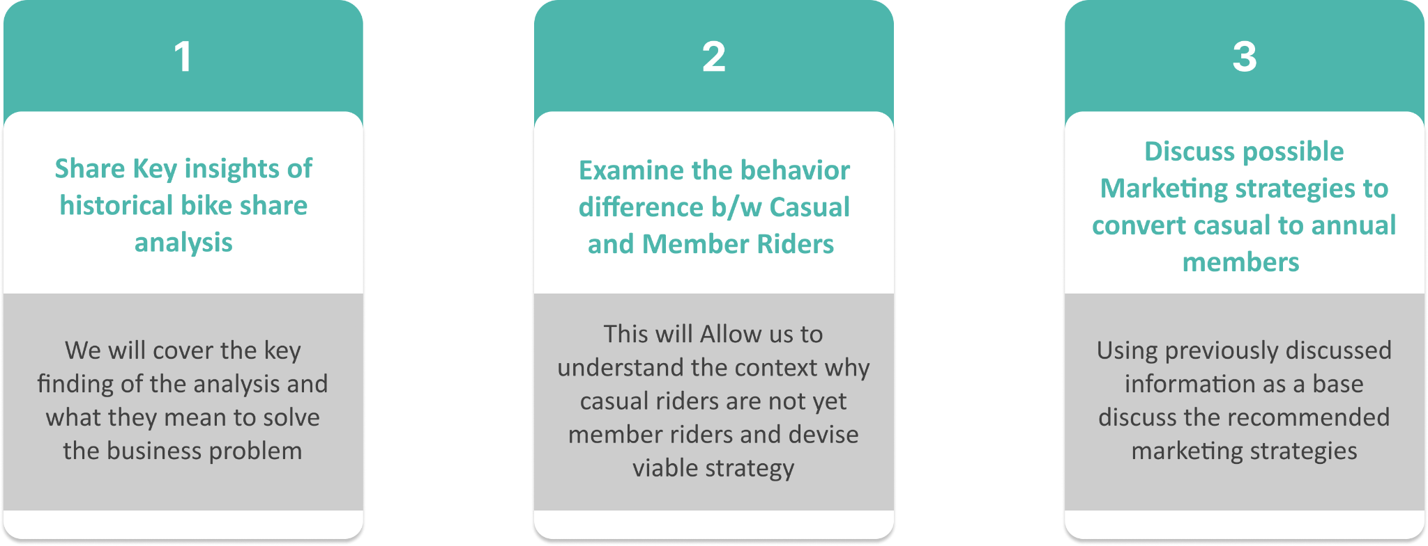
Goals for our discussion today:

Slide 3
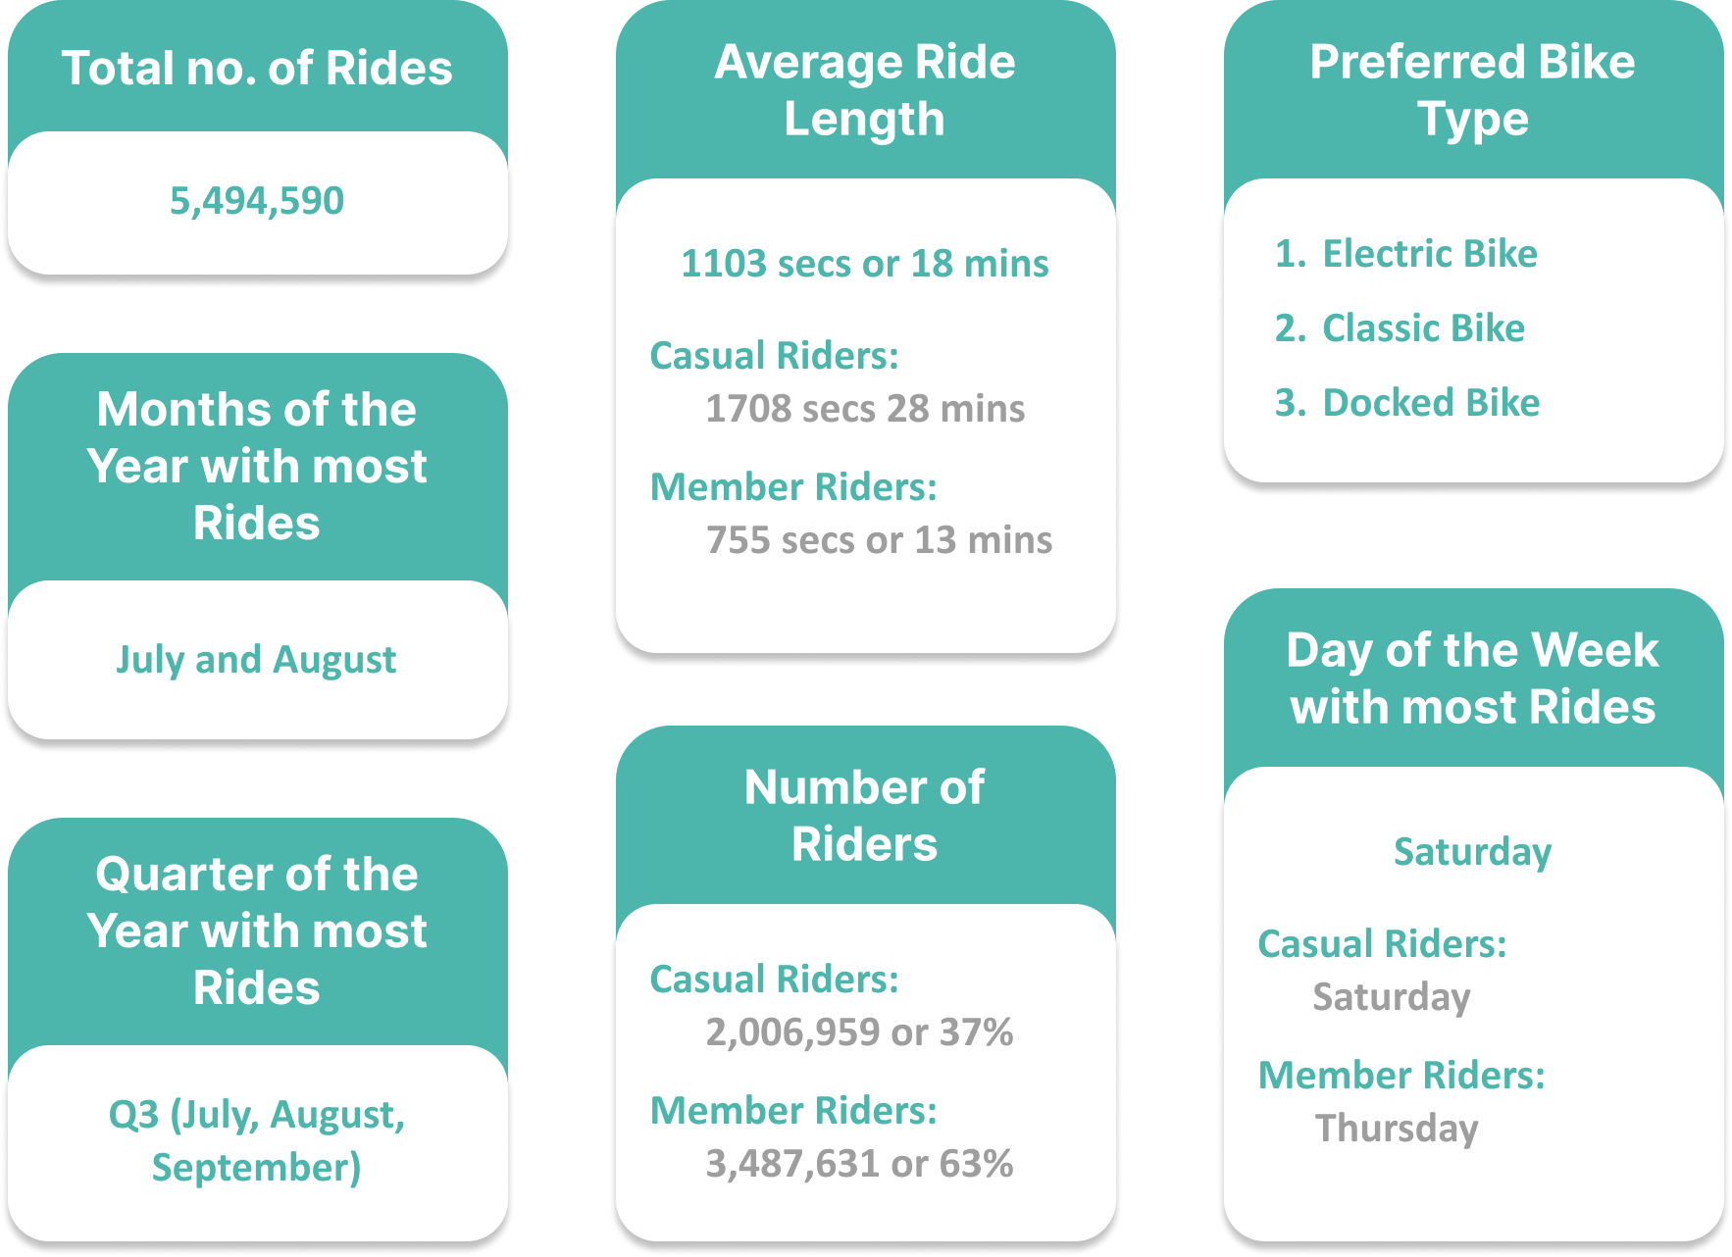
Key Insights from analysis of the historical bike share data:

Slide 4
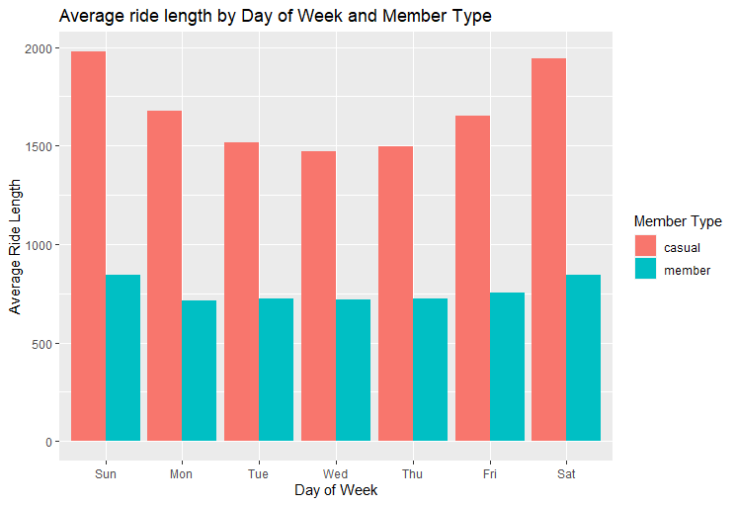
Understanding Trends and Patterns that separate Casual Riders from Member Riders
Member riders have a significantly shorter average ride length than casual riders.
The average ride length for both member and casual riders is highest on Sundays and Saturdays, and lowest on Tuesdays and Wednesdays.
There are significantly more member riders than casual riders.

Slide 5
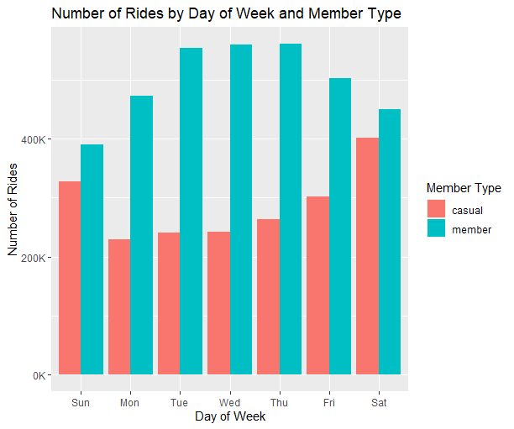
Understanding Trends and Patterns that separate Casual Riders from Member Riders
Members have higher ridership on weekdays (Tuesdays, Wednesdays, Thursday) suggesting regular use for commutes or errands.
Casuals have a significantly higher ridership on weekends (Saturdays and Sundays). Weekday activity is lower but still present.
Where Members have high ridership the Casual have lower ridership and vise-versa. This provides insight into the kind of activities performed by both categories.

Slide 6
Marketing Strategy Recommendations to convert Casual to Member Riders
Q3 Exclusive Annual Membership Offer: Introduce a new annual membership plan specifically designed for casual behavior, with Discounts, Event-Themed Plans offering limited-edition memberships linked to popular summer events, festivals, or seasonal activities while emphasizing the cost savings and ease of use compared to frequent single-ride and full day purchases.
Partner for Additional Value and Visibility: Expand reach and appeal by collaborating with local businesses and attractions. Highlight the convenience of accessing perks at nearby coffee shops, restaurants, or gyms close to docking stations along with offering targeted promotions during peak seasons.
Create a Rewarding Membership Experience: Introduce Cyclistic Loyalty Points System for members based on the number of rides or ride lengths redeemable for bike discounts, merchandise or entry to fun exclusive member riding events. Introduce Members-Only Perks providing access to dedicated stations, priority bike rentals, or special discounts at partner businesses near popular routes.

